Slide 1

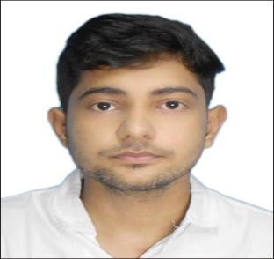
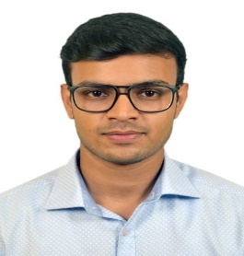
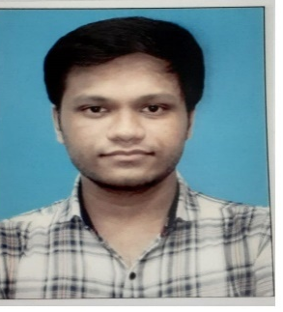
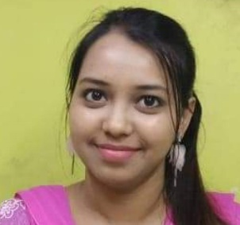
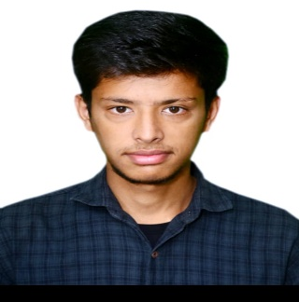
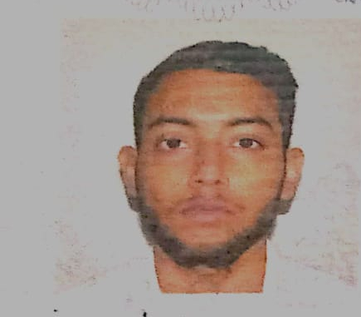
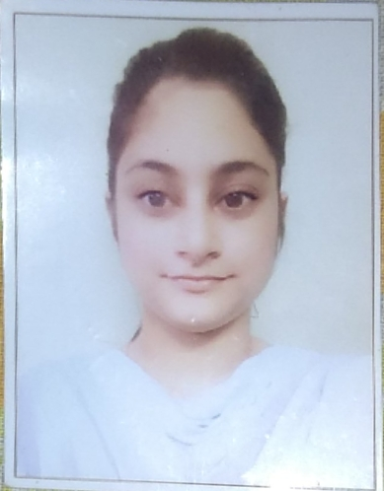
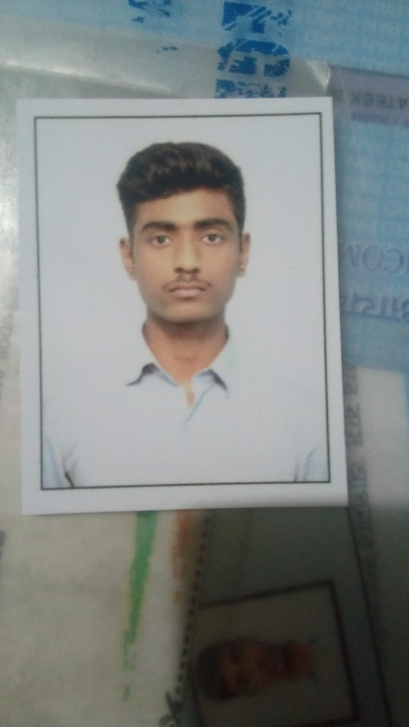
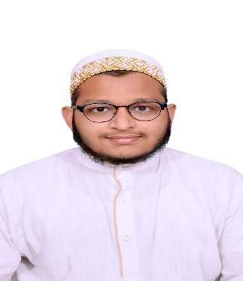
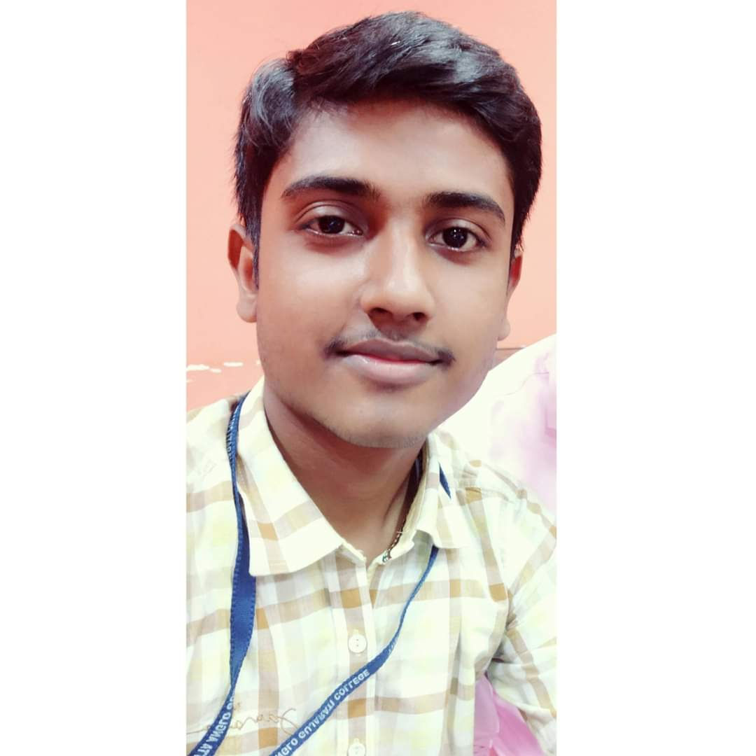
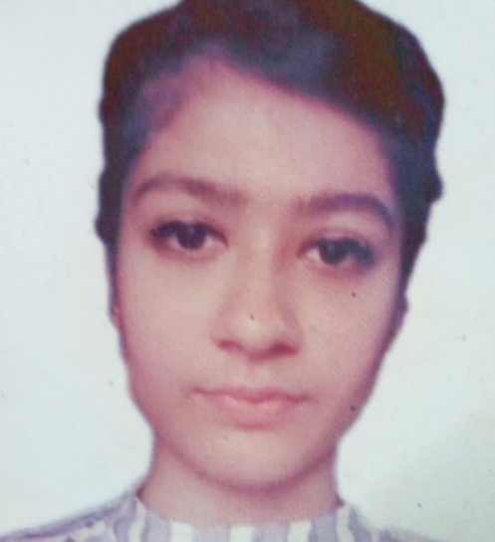
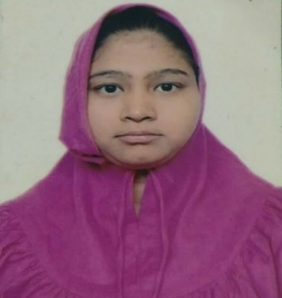
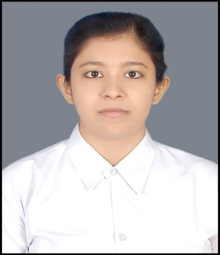
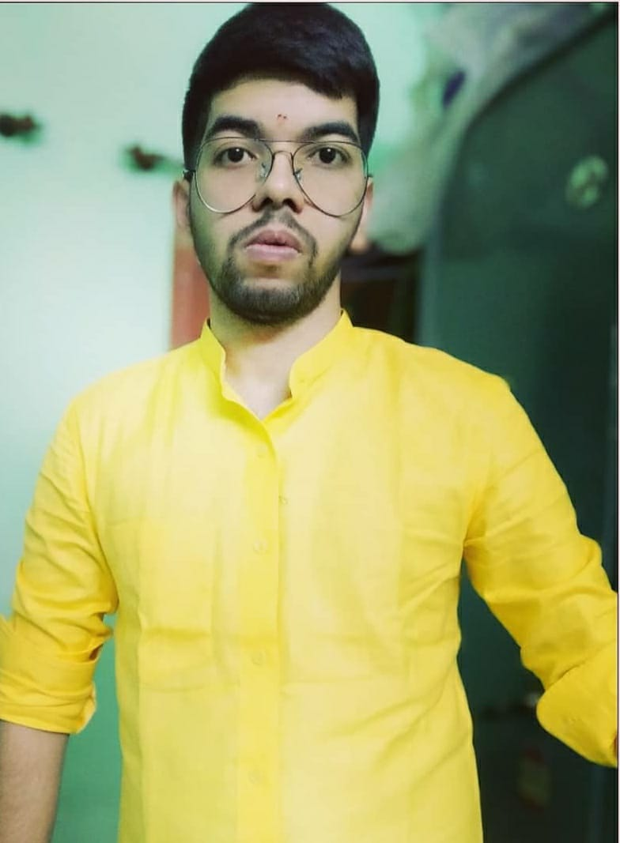
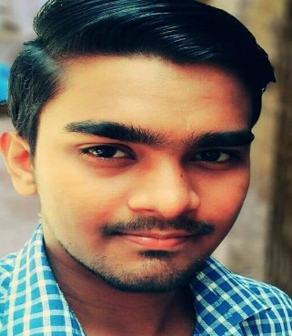
THE CALCUTTA ANGLO GUJARATI COLLEGE
PLACEMENT ZONE (BBA/BCA)
MUBASSIR HUSSAIN KHAN (BCA)
(GENPACT, WIPRO, AMAZON)
CHANDAN SHAW (BCA)
(TCS, INFOSYS, WIPRO, GENPACT)
AMREEN ZULFIQAR (BBA)
(GENPACT)
AJAY ACHARYA (BCA)
(WIPRO)
MOMIN SHAFI (BCA)
(AMAZON, GENPACT)
DIPAK MANDAL (BCA)
(WIPRO)
SARIM KHAN (BCA)
(TCS)
DARAKSHA ZAHID (BBA)
(TCS)
PRATEEK BARNWAL (BCA)
(TCS)
HAMZA SHAKIR (BCA)
(CTS)
TANISHA KOTECHA (BCA)
(AMAZON, GENPACT)
MUBARAKA (BCA)
(CTS)
KANCHAN SINGH RATHORE (BCA)
(CTS)
VIMAL (BCA)
(WIPRO)
RAHUL SHAW (BCA)
(TCS)

Slide 2
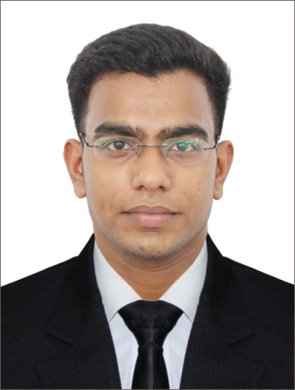
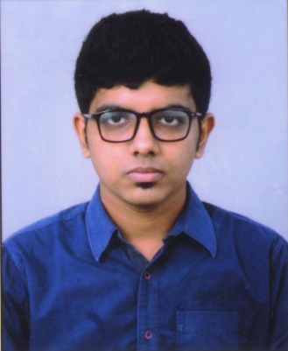
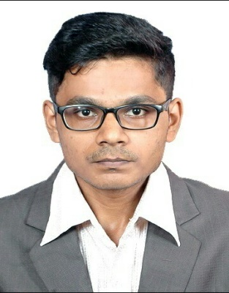
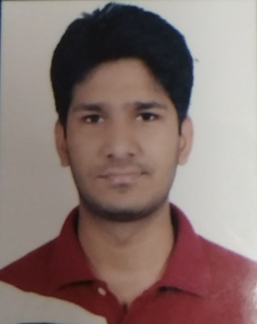
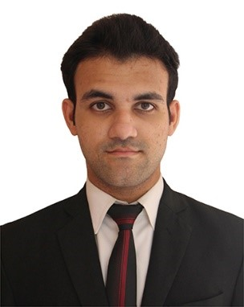
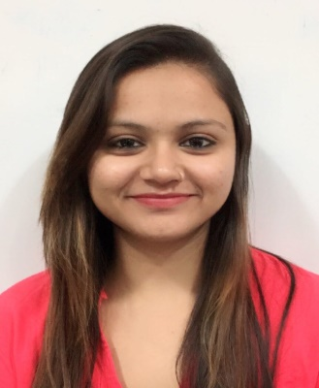
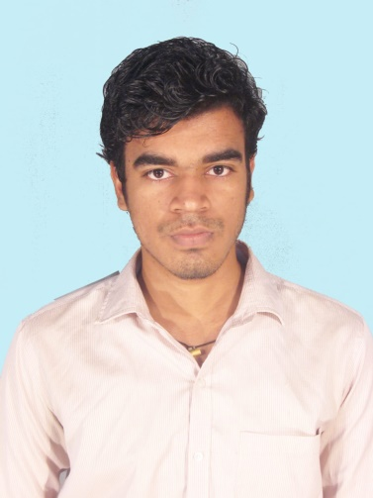
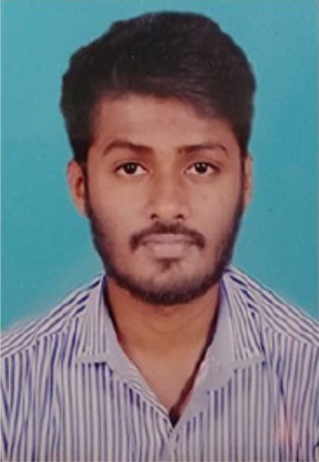
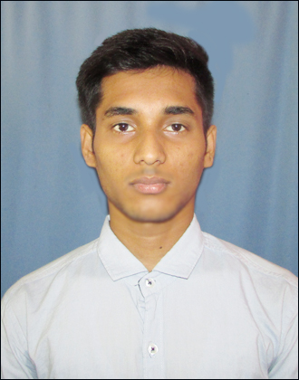
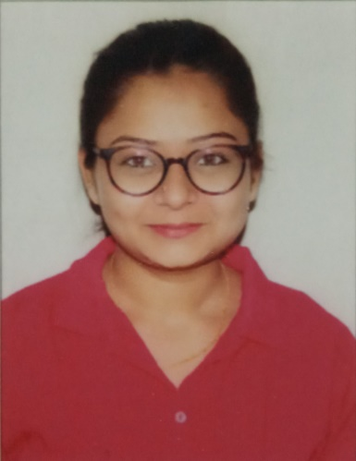
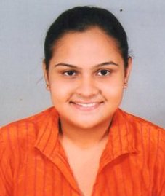
THE CALCUTTA ANGLO GUJARATI COLLEGE
PLACEMENT ZONE (BBA/BCA)
AMIT PANDEY (BCA) CAPGEMINI
CHIRAG MEHTA (BCA) CAPGEMINI, TCS, COGNIZANT
SHREY SHAH (BBA) CONCENTRIX
SHARIQ RAZA(BBA) CONCENTRIX
WALEED RAHMAN (BBA) CAPGEMINI
TWINKLE MALAVIA (BBA) CAPGEMINI
RAHUL SHUKLA (BCA) CAPGEMINI
ANKIT SHARMA (BBA) CAPGEMINI
SUBHENDU BISWAS (BCA) TCS
TWINKLE PATEL (BBA) CAPGEMINI
VIDHI MEHTA (BCA) CAPGEMINI

Slide 3
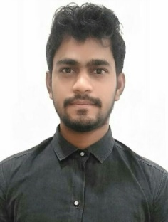
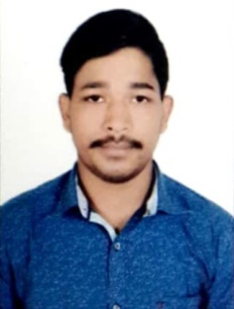
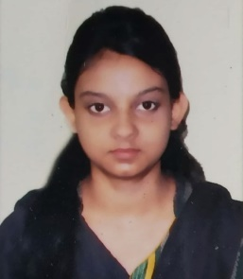
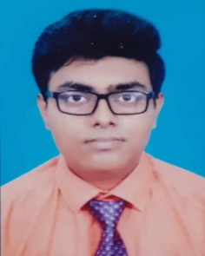
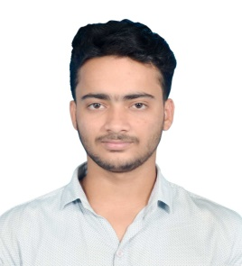
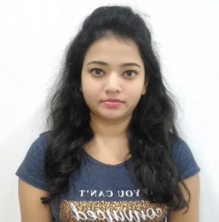
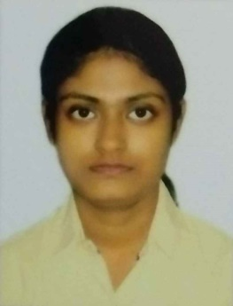
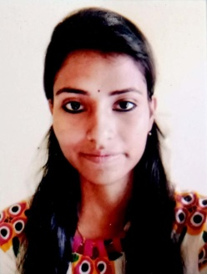
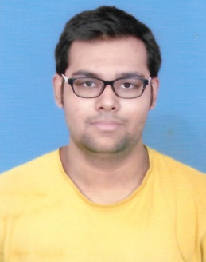
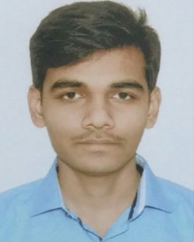
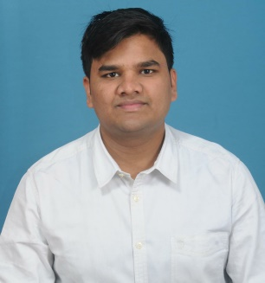
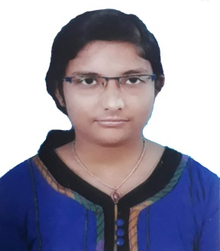
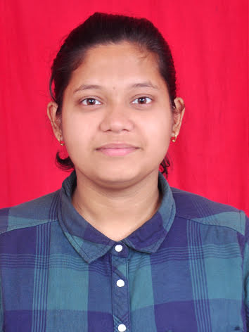
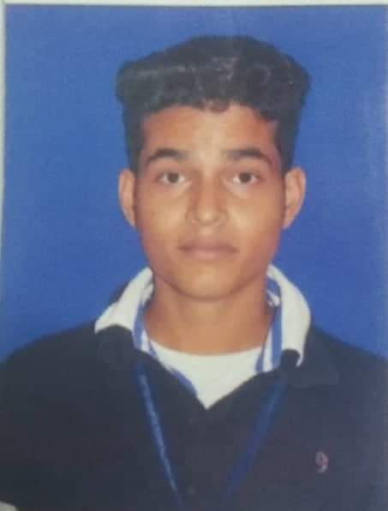
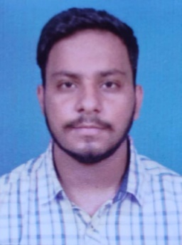
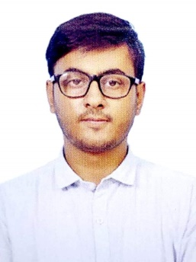
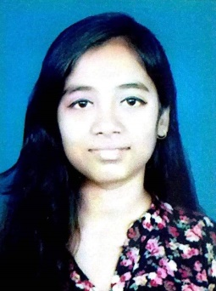
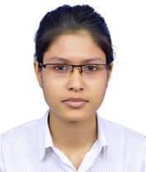
THE CALCUTTA ANGLO GUJARATI COLLEGE
PLACEMENT ZONE (BBA/BCA)
MD. GULAM (BBA)
XPLORE-TECH SERVICES
YASH ROY (BBA)
CONCETRIX
AALFIA MEHNDI (BCA) CONCENTRIX
MRINMOY SAHA (BCA)
COGNIZANT
SHIVAM CHOUDHARY (BCA)
INFOSYS & TCS
SIMRAN SHAW (BCA)
TCS & XPLORE TECH
DEBOSMITA CHOWDHURY (BCA)
TTELEMINDS
MADHURIMA BHAGAT (BCA) TCS
NIKHIL ARORA (BCA)
TCS
GANESH KUMAR SHAW (BCA) INFOSYS
ROHAN KUMAR (BBA)
TCS
SHREYA KARMAKAR (BCA)
TCS, WIPRO & INFOSYS
NEHA RAY (BCA)
AMAZON
SOURAV CHOUDHARY (BCA)
AMAZON
ROHAN PAREKH (BBA)
TCS
HARSHIT SHAH (BCA)
WIPRO
SWEETY SINGH (BCA)
WIPRO
RAGGI CHAKRABORTY (BCA)
TCS

